Slide 1

Module 5
Model Building
Notes:
Guidelines
Use section headers to chunk content in your presentation.
Use the same style of section header throughout your presentation.
Keep your title to no more than 2 lines.

Slide 2
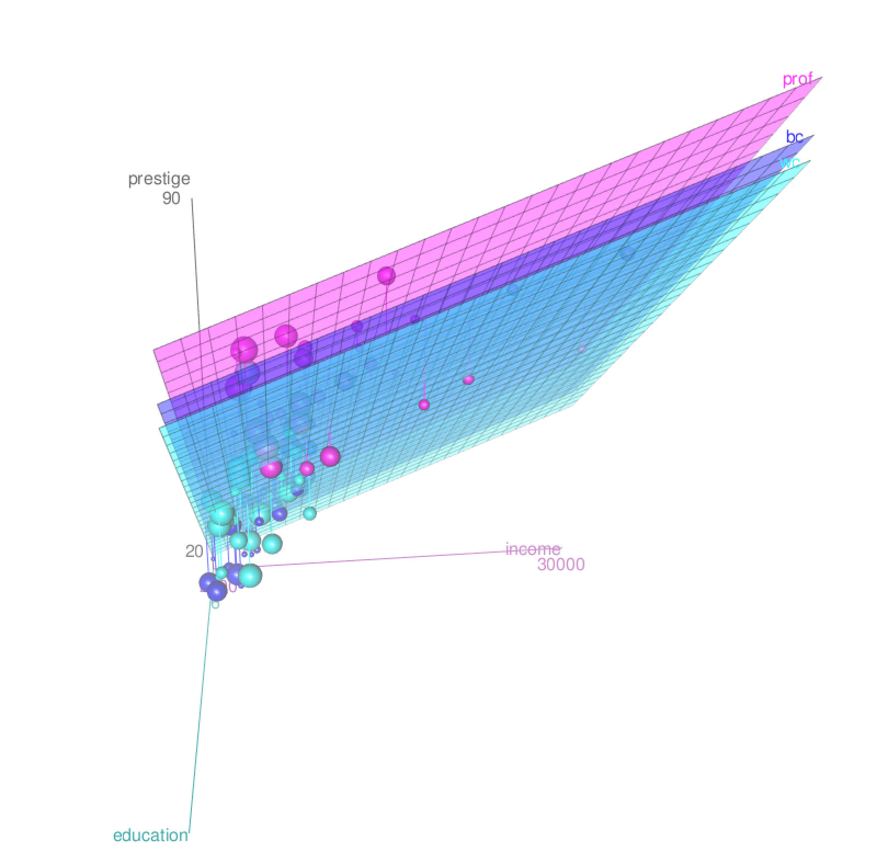
Model Complexity
Notes:
Guidelines
Use a title slide at the beginning of your presentation. There are 9 variations of title slides to choose from.
If you will have a series of slideshows, we recommend using the same style of title slide for each presentation.
Keep your title to no more than 2 lines.
Do not change the font style or font size of the title or subtitle.

Slide 3

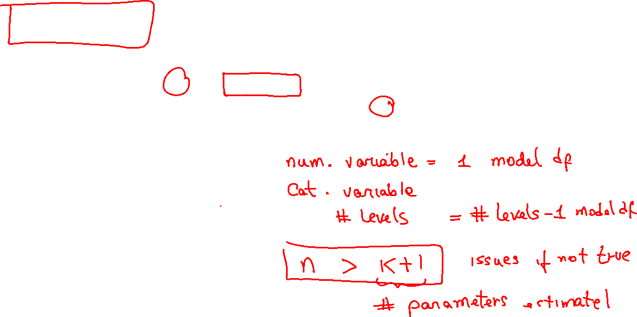
Model DF: Model Complexity
The model df ($k$) is a measure of complexity of a model.
For statistics to be estimable, we need $n$ to be larger than $k + 1$.
Total parameters estimated $k + 1$ is a good complexity measure

Slide 4

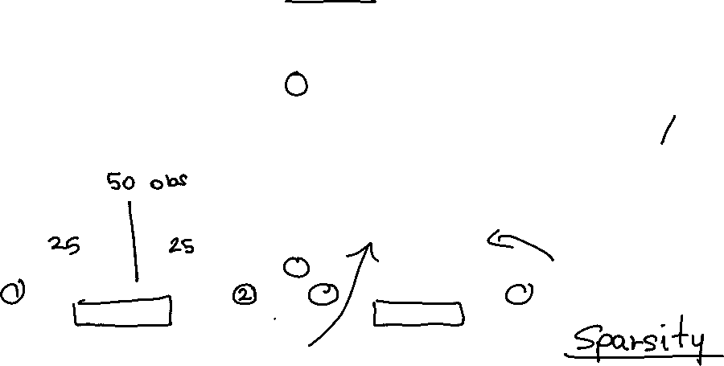
The Curse of Dimensionality
As the model df ($k$) increases, the points are more spread.
The higher the model df ($k$), the more observations are needed

Slide 5
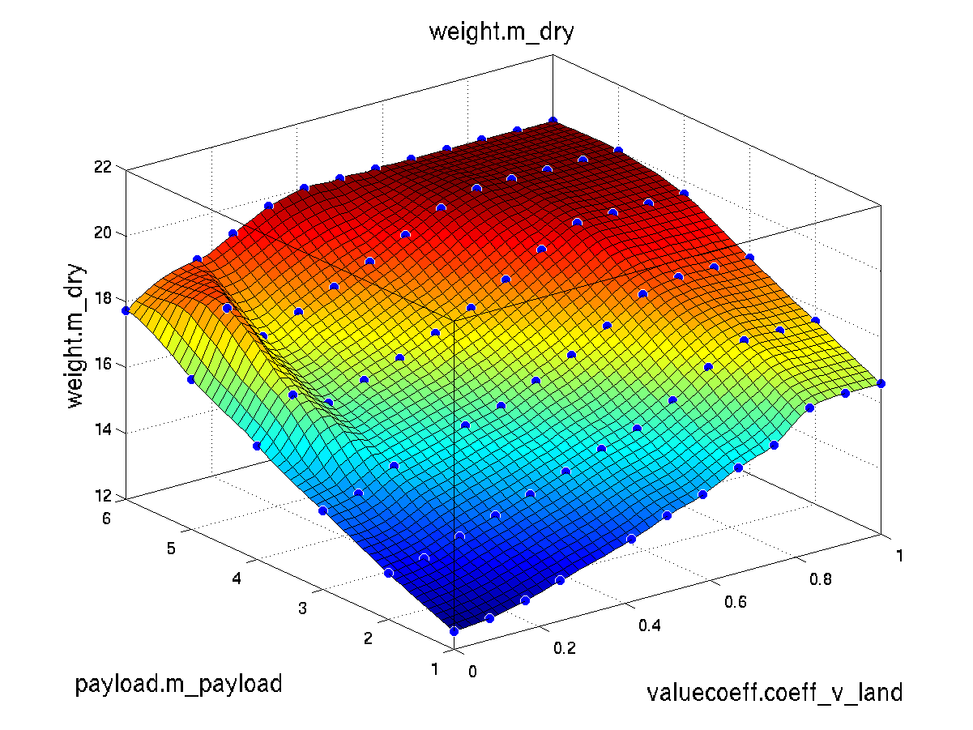
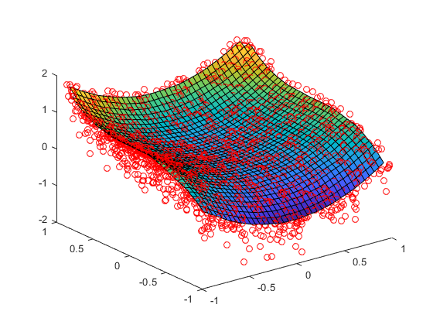

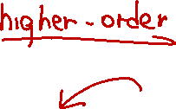
The Curse of Dimensionality
As the model df ($k$) increases, the points are more spread.
The higher the model df ($k$), the more observations are needed

Slide 6

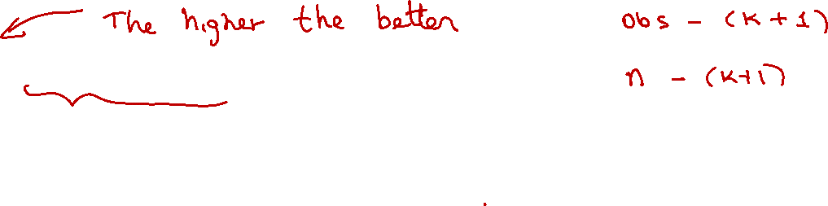
Error Degrees of Freedom
The minimum number of observations needed is $k + 1$.
The error degrees of freedom is $n−(k + 1)$

Slide 7

Practice

Slide 8
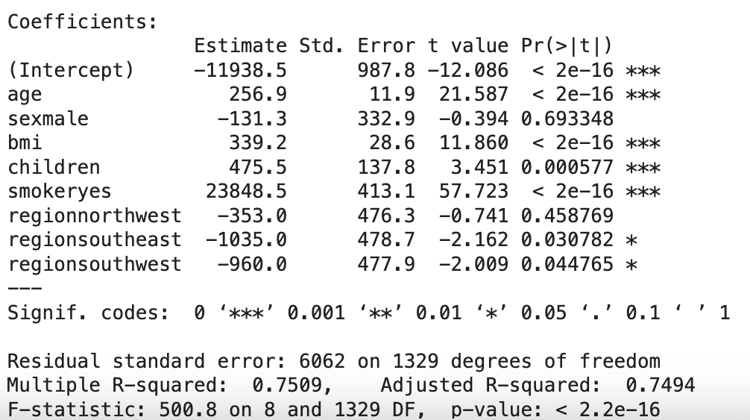
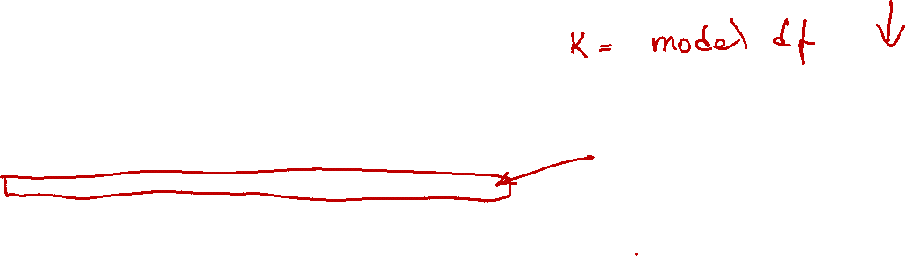
Categorical Variables
It is common to encounter categories with many unique levels
It is also that some categories are not statistically significant

Slide 9
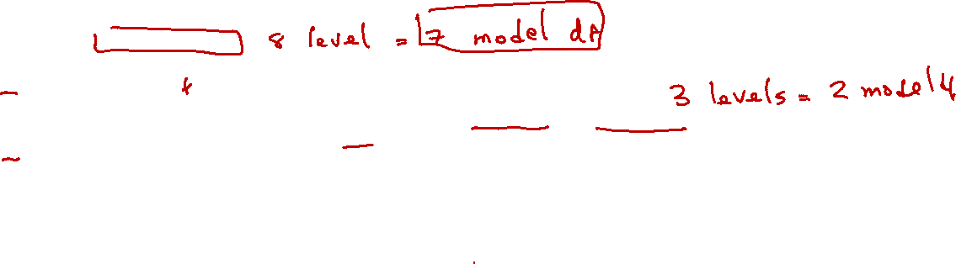
Collapsing Levels Categorical Variables
Collapsing or grouping levels is important for several reasons:
Simplifies the model
Reduces sparsity
Prevents overfitting
Improves computational efficiency
VARIABLE: BUYER SEGMENT
Luxury Buyer
Discount Shopper
Frequent Buyer
One-Time Buyer
Occasional Buyer
Seasonal Buyer
Gift Purchaser
Window Shopper
COLLAPSED VARIABLE: BUYER SEGMENT
Frequent Buyer (Luxury Buyer + Frequent Buyer)
Occasional Buyer (Occasional, Seasonal, Gift Purchaser)
Low Engagement Buyer (Discount, One-Time, Window Shopper)

Slide 10

Collapsing Levels Categorical Variables
Collapsing or grouping levels is important for several reasons:
Simplifies the model
Reduces sparsity
Prevents overfitting
Improves computational efficiency
VARIABLE: BUYER SEGMENT
Luxury Buyer
Discount Shopper
Frequent Buyer
One-Time Buyer
Occasional Buyer
Seasonal Buyer
Gift Purchaser
Window Shopper
COLLAPSED VARIABLE: DISCOUNT_SHOPPER
Discount Shopper
Other

Slide 11
Practice

